Slide 1
Working Together,
Achieving More
Cydweithio a Chyflawni
Year 10 and 11 Information Evening
21st October 2021
Science

Slide 2
Course content and delivery
Give a brief outline of the course content and the method of delivery over the 1 – 2 years
Double Science and Triple Science are both 2 year courses.
External exams are sat in both Year 10 and Year 11, contributing to the overall GCSE grade/s obtained.
The Year 10 grades are important as they DO contribute towards the final GCSE grade/s.

Slide 3
Assessment
How is the course assessed?
External written exams in Biology, Chemistry and Physics in Year 10 & 11. All contribute towards the final GCSE grade/s.
There is no coursework to complete, but usually there is a practical exam in Jan / Feb of Year 11. However for current Year 11 this practical will NOT go ahead, due to COVID.
When will the assessments take place?
Written exams in May / June of Year 10 & Year 11
Practical exam in Jan / Feb of Year 11 (but not in 2022)

Slide 4
Assessment
What preparation needs to be done beforehand?
Throughout the course there are end of topic tests which should be considered important milestones.
Complete all homework which is set on Google classroom.
Some pupils will have the opportunity to be part of the interactive revision system called Tassomai, so completing 4 daily goals a week will optimise learning.
Will pupils have resit opportunities to improve their results?
Exams can be resat from Year 10 when pupils are in Year 11, although we do not encourage this as it puts extra strain on pupils.

Slide 5
Skills Development
What skills will pupils develop through studying the course and how will they do this?
Develop scientific thinking
Experimental skills and strategies
Analysis and evaluation
Scientific vocabulary, units, symbols, quantities and nomenclature
Numerous mathematical skills
What can they do to practise these skills?
Complete all homework set by the class teacher.
Use WJEC question bank for more examples of questions.

Slide 6
How can these skills be applied to different subjects/areas of life?
Science provides a broad, coherent, satisfying and worthwhile course of study. It encourages learners to develop confidence in, and a positive attitude towards, science and to recognise its importance in their own lives and to society.
Studying GCSE Sciences provides the foundations for understanding the material world. Scientific understanding is changing our lives and is vital to the world’s future prosperity, and all learners should be taught essential aspects of the knowledge, methods, processes and uses of science.
They should be helped to appreciate how the complex and diverse phenomena of the natural world can be described in terms of a small number of key ideas relating to the sciences which are both inter-linked, and are of universal application.

Slide 7
Our Expectations
What are your expectations in terms of
presentation of work?
All booklets should be neat and up to date.
homework?
Homework is set on Google classroom, with deadlines to help get organised.
preparation for assessments?
Complete all the classwork and homework set. For extra preparation use WJEC question bank to find more questions to try out.
Equipment needed for lessons/exams?
For every lesson presume you need a pen, pencil, ruler, rubber and a calculator.

Slide 8
Resources and Support
What resources will you make available to support learning?
Selected pupils will have free access to Tassomai to aid revision.
Google classroom has resources specific to your subject areas. All other resources are on Google classroom pages.
What support both within and outside lessons will be provided to support pupils?
Pupils can email their teachers in Science for support and help, or ask within Google classroom on something specific.

Slide 9
How can parents/carers support their children in your subject?

Slide 10
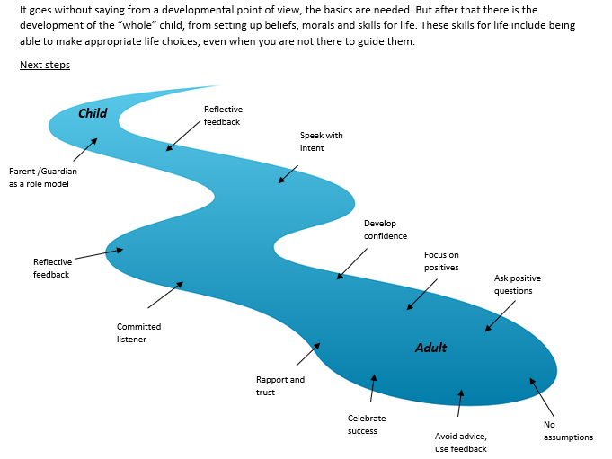

Slide 11
Parents information guide from Tassomai

