Slide 1
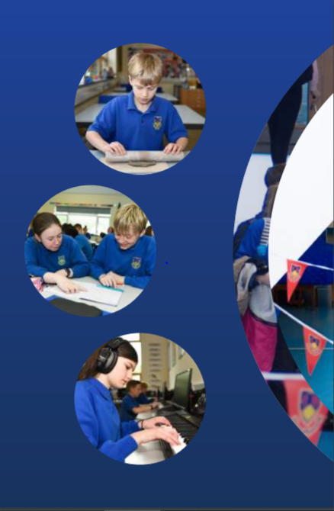
Working Together,
Achieving More
Cydweithio a Chyflawni
Year 10 and 11 Information Evening
21st October 2021
Mathematics

Slide 2
Course content and delivery
Pupils will complete two qualifications,
GCSE Mathematics and GCSE Mathematics –Numeracy
They are both 2 year courses with all examinations taking place at the end of the course.
There is no coursework for either qualification.
There are three tiers of entry; Higher, Intermediate and Foundation, and pupils are entered for the appropriate tier independently for Mathematics and Numeracy
GCSE Mathematics will build on the progress, skills, knowledge and understanding developed over the course of KS3. Whilst GCSE in Mathematics – Numeracy will assess the mathematics that learners will need in their everyday lives, in the world of work, and in other general curriculum areas, GCSE Mathematics will extend to aspects of mathematics needed for progression to scientific, technical or further mathematical study.

Slide 3
Assessment
How is the course assessed?
Both Mathematics and Numeracy are assessed by external written examinations. There are two written papers for each, one non-calculator and one with calculator allowed.
When will the assessments take place?
All examinations will take place in the summer term of Year 11
What preparation needs to be done beforehand?
Throughout KS4 pupils will be working on exam standard questions and complete end of unit tests to monitor progress. Extensive use is made of past papers throughout Year 11 in the build up the examinations.
Will pupils have resit opportunities to improve their results?
If pupils wish to resit either qualification, this would need to be done the following academic year, either in November or the following summer.

Slide 4
Skills Development
What skills will pupils develop through studying the course and how will they do this?
Pupils will develop knowledge, skills and understanding of mathematical methods, techniques and concepts. They will learn to reason mathematically, construct arguments and simple proofs, and make logical deductions and inferences. They will practice interpreting mathematical results and learn to draw and justify conclusions and communicate mathematical information in a variety of forms.
What can they do to practise these skills?
Pupils will work on problems set both in real-world contexts and within mathematics itself. They will be encouraged to employ and evaluate different mathematical techniques.
How can these skills be applied to different subjects/areas of life?
The Numeracy syllabus emphasises the knowledge, skills and understanding of mathematical and statistical methods, techniques and concepts required for everyday life, in the world of work, and in other general curriculum areas.

Slide 5
Our Expectations
Presentation of work:
All work needs to be completed on time to an appropriate standard with clear workings out shown. Diagrams should be drawn with pencil and a ruler.
Homework:
Regular homework is set for all pupils. Many of the tasks are set on Mathswatch which needs to be completed online. If a pupil does not have access to a device at home, provision will be made in school for this to be completed.
Preparation for assessments:
Revision tasks/ review exercises will be set for each assessment. It is important that these are completed early so that sufficient time can be spent on target topics that need further practice.
Equipment needed for lessons/exams:
For each lesson you will be expected to have a pen, pencil, basic geometry set and a scientific calculator.

Slide 6
Resources and Support
Resources available to support learning:
Support for pupils:
The work for every maths lesson is available electronically via the lesson planner on Google classroom.
All pupils have access to Mathswatch, which includes video tutorials and interactive questions to support independent learning.
All pupils will be provided with extensive revision materials, including past papers to be completed.
How can parents/carers support their children?
Help your child be organised - the key to effective revision.
Make sure all homework tasks are up to date.
Be actively involved in your child’s revision planning.
Make sure they have a quiet and uncluttered study space at home.
Read through exam questions with your child and ask them to explain the questions and their answers.
Use revision guides and summary notes to test their knowledge of facts and encourage pupils to write their own.
Encourage them to work for shorter periods, more frequently.

Slide 7
Resources and Support
Links to Online Resources
Mathswatch
Maths DIY
WJEC question bank
GCSE pod

