Slide 1
Working Together,
Achieving More
Cydweithio a Chyflawni
Year 10 and 11 Information Evening
21st October 2021

Slide 2
The Pastoral Team
Year 10 Pastoral Support
Year 11 Pastoral Team
10PSM – Mr Paul Martin
10KR – Mrs Emma Elliott
10KG – Miss Katy Gullam
Pastoral Support Officer – Mr Huw Thomas
11Y – Miss Alyson Thomas
11S – Mrs Jessica Wright
11A – Ms Jan Millar
11D - Miss Hayley Lougher
Learning Support Officer – Mrs Lucy Watkins

Slide 3
Pastoral Support/Interventions
-Progress Tutor mentoring
-Pastoral support
-Youth Intervention Service (YIS)
-In-School counsellors
-Trauma Informed Schools approaches
-KOOTH counselling services
-Behaviour support
-Emotional support
-Academic support
-Bespoke curricula
-Careers support (on-site contact)
-PSE days
-6th Form Options Process

Slide 4
Formal/External Assessments
Year 10 (completed this academic year)
Year 11
10/10 Option – FULL COMPLETION by Summer 2022
English Literature – January 11th Written paper
Geography – Non-Examinable Assessment (December 2021)
Mathematics – ASPIRE group (Y10) complete Entry level
Science – GCSE examinations (units 1-3)
Entry level examinations units 1&2 (ASPIRE)
RE – Written examinations Summer 2022
Welsh – Speaking exam (date tbc)
PE – Practical assessment around Easter
Completion of ALL qualifications by the end of summer examination session
Some examination alterations have been made due to COVID e.g. Science practical assessments won’t run

Slide 5
Mock Examinations
-Not envisaging a fixed mock exam period this year
-Subjects are selecting the best timing dependent on work completed/intended outcomes
-Parents will be notified of dates/times and of any changes
Purposes: -
-Allow pupils opportunity to experience examinations
-Allow diagnostic testing tio inform next steps

Slide 6
Mock Examinations
It is VITALLY important that your child prepares correctly for mocks
-Allows us to determine how best to help your child
-Gives your child the best possible chances of success
What can parents/carers do to help? Encourage your child to…
-Plan out preparation
-Speak to their teachers about aspects they struggle with
-Ensure preparation starts in good time
-Use revision materials/Virtual Learning Environments provided e.g. GCSE Pod, MathsWatch and Tassomai

Slide 7
Preparation for Assessments
Attendance and Punctuality
Opportunities for Revision
Preparation for Learning and Work Ethic

Slide 8
Attendance
Attendance at school is KEY
The MINIMUM target for attendance is 95%
A pupil who achieves this target will still have missed 50 hours of learning
Attendance during one school year | Equals days absent | Approximate number of weeks absent | Number of lessons missed
95% | 9 days | 2 weeks | 50 lessons
91% | 17 days | ~3 ½ weeks | 85 lessons
90% | 19 days | 4 weeks | 100 lessons
85% | 29 days | 6 weeks | 150 lessons
80% | 38 days | 8 weeks | 200 lessons
75% | 48 days | 10 weeks | 250 lessons
17 days absence
A drop of one grade in ALL subjects studied
=
How can parents/carers help?
Encourage your child to attend school EVERY day
Take a pragmatic approach if your child tells you they are ill
Help ensure missed work is caught up

Slide 9
Punctuality
Excellent punctuality to school is as important as attendance
The most important 5 minutes of a lesson is the introduction
Your child will be on the back foot throughout the rest of the lesson if they miss it
Lateness = Lost Learning (Figures below are calculated over a school year)
5 minutes late each day | ~3 days lost
10 minutes late each day | ~6 ½ days lost
15 minutes late each day | ~10 days lost
20 minutes late each day | ~13 days lost
30 minutes late each day | ~19 days lost
How can parents/carers help?
Encourage your child to attend school AND each lesson on time
Talk to them about the importance of being on time

Slide 10
Opportunities for Revision – GCSE Pod

Slide 11
Opportunities for Revision - MathsWatch

Slide 12
Opportunities for Revision - Tassomai

Slide 13
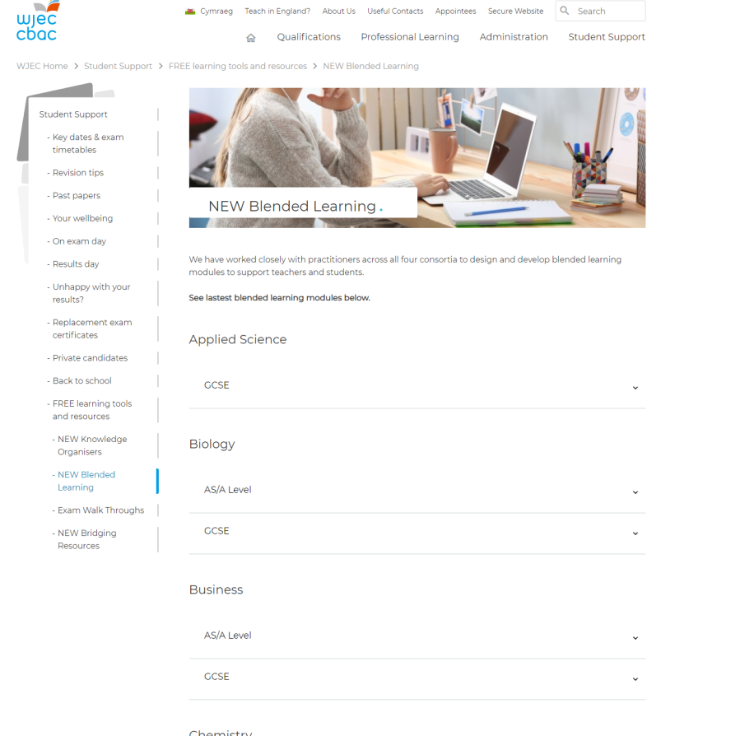
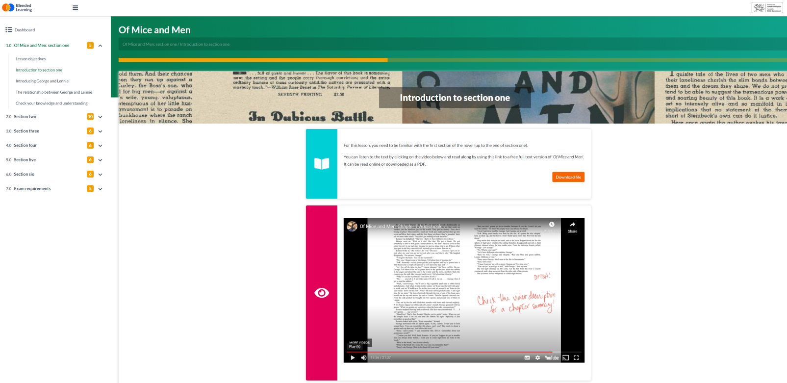
Opportunities for Revision – WJEC Blended Learning Materials
-One of the benefits of lockdown is the production of MANY blended learning materials by the WJEC
Link here

Slide 14
Supporting Your Child – Hints and Tips
Ensure your child knows what their upcoming deadlines are
-When are their examinations being held?
-Are there any coursework/Non-Examinable Assessments? When?
Ensure that homework and revision tasks are started in good time
-The best time to complete work at home is the same evening as it is given
-The work is still fresh in your child’s mind and they will find it easier and more profitable
Ensure that they have somewhere quiet to work, away from distractions
-Mobile phones
-Televisions
-Games consoles

Slide 15
Supporting Your Child – Revision Tips
Revision websites: -
S-cool.co.uk
BBC Bitesize
Physics and Maths Tutor (not just for Physics and Maths)
Revisionworld
Youtube (revision videos)

Slide 16
Supporting Your Child – Hints and Tips
Talk to your child about the importance of trying their best and aiming to at least meet their target grades
Ensure that your child asks for help and support as and when necessary – don’t leave it until just before the exam!
Encourage them to start preparing early
-Keeping up to date with Daily Goals on Tassomai
-Complete their MathsWatch tasks
-Use GCSE Pod to revise topics or ideas that they struggle with
Make sure that they make time for exercise and time away from preparation

Slide 17
Supporting Your Child – Hints and Tips
Encourage your child to check they have the correct equipment for learning each day: -
-Basic stationary e.g. pen, pencil, ruler calculator
-Books/files and completed homework for each timetabled lesson
-Subject specific equipment e.g. PE kit, ingredients for Food Technology
Recommended calculator link (CASIO FX83) – available online or in-store

Slide 18
Supporting Your Child – Hints and Tips
Discuss the value of good education and the life-long benefits
Highlight the life-long skills developed – literacy, numeracy, problem solving, critical thinking, creative thinking and many others
Specific courses and skills: -
-SWEET – develops your child’s personal, social and emotional wellbeing, giving them strategies to lead a fulfilling future
-LiFE – Financial qualification, developing money and financial skills and sense
-Skills Challenge Certificate – develops problem solving and independent working skills (training your child up in the skills required for 6th Form, College and University)

Slide 19
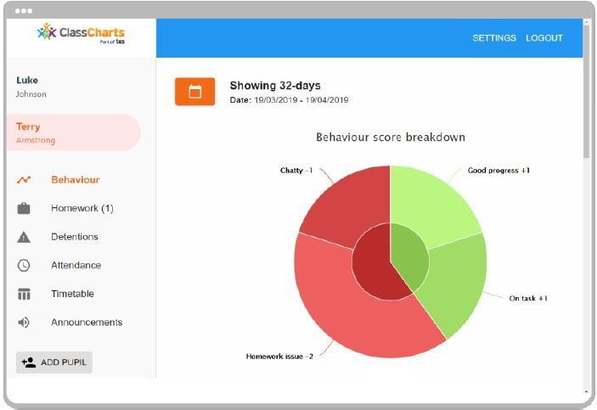
Supporting Your Child – Classcharts
-Use your Classcharts login to track your child’s progress lesson-by-lesson
-Speak to your child about any issues that arise
-Celebrate their successes
-Contact us if there are concerns

Slide 20
Contact Us
Telephone – (01639) 842115
Email – office@maesydderwen-hs.powys.sch.uk
Facebook – facebook.com/Maesydderwen
Twitter - @Maesydderwen
Schoop – Downloadable app (activation code 20472)

