Slide 1
Working Together,
Achieving More
Cydweithio a Chyflawni
Year 10 and 11 Information Evening
21st October 2021
GCSE ICT

Slide 2
Course content and delivery
GCSE ICT is a Single Award GCSE by WJEC.
It is the final year of awarding this subject by WJEC.
It’s taught over 2 years and learners are currently in their second year of the course.
Over the two years learners will acquire knowledge and skills in the following areas; spreadsheets, databases, multimedia communication, desk top publishing, networks, operating systems, quality of data, home business & entertainment, legal & health implications along with emerging technologies.

Slide 3
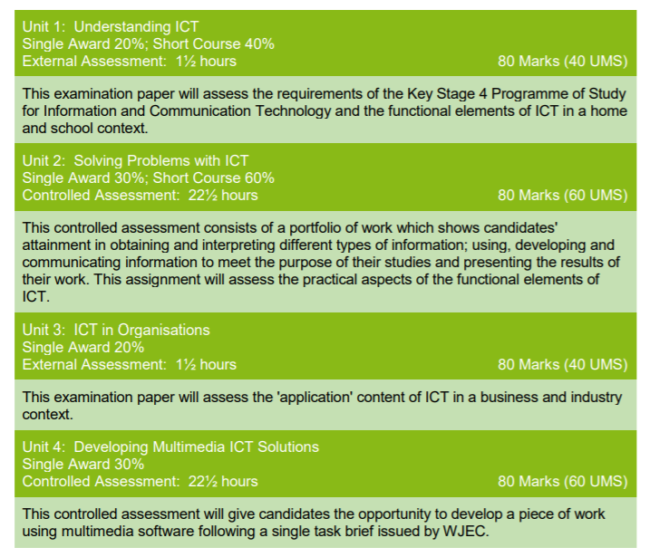
Assessment
In Year 10 learners completed Unit 2 controlled assessment.
During Year 11, learners will complete Unit 4 controlled assessment and Unit 3 external written examination.
Unit 4 controlled assessment is currently being undertaken during timetabled lessons.
Unit 3 will commence in the Spring term.

Slide 4
Skills Development
GCSE ICT provides opportunities to develop candidates’ skills, particularly those in problem solving, use of IT and communication. They will also have opportunities to develop their skills in application of number, working with others and improving own learning and performance.
It is also of benefit to the learners to keep practising their skills in using and creating spreadsheets, databases, newsletters learnt last year at home and in their other subject areas.
During lockdown their communication skills using ICT greatly improved!

Slide 5
Expectations
During the final year of the course it is expected that learners make every effort to attend all ICT lessons as this will aid in completion of the Unit 4 Controlled Assessment prior to Christmas.
In the new year Unit 3 will be the focus.
Learners will be expected to undertake independent revision alongside homework and classwork.
Homework will be set to aid with learning of the theory in preparation for the external written exam in June.

Slide 6
Resources and Support
In order to support independent learning at home, learners can use GCSE Pod which covers all the theory required for Unit 3. This will also be used as part of assessment and homework during the year.
Past paper questions will be given to aid with learning during lessons as well as a revision check list. Past papers along with mark schemes for the course are also available on the WJEC website.
Revision sessions will be offered to learners closer to the external exam.
Please encourage attendance to lessons and the use of GCSE Pod as part of revision.

