Slide 1
Working Together,
Achieving More
Cydweithio a Chyflawni
Year 10 and 11 Information Evening
21st October 2021
GCSE Health, Social and Child Care

Slide 2
Course content and delivery

Slide 3
Assessment

Slide 4
Skills Development

Slide 5
Our Expectations

Slide 6
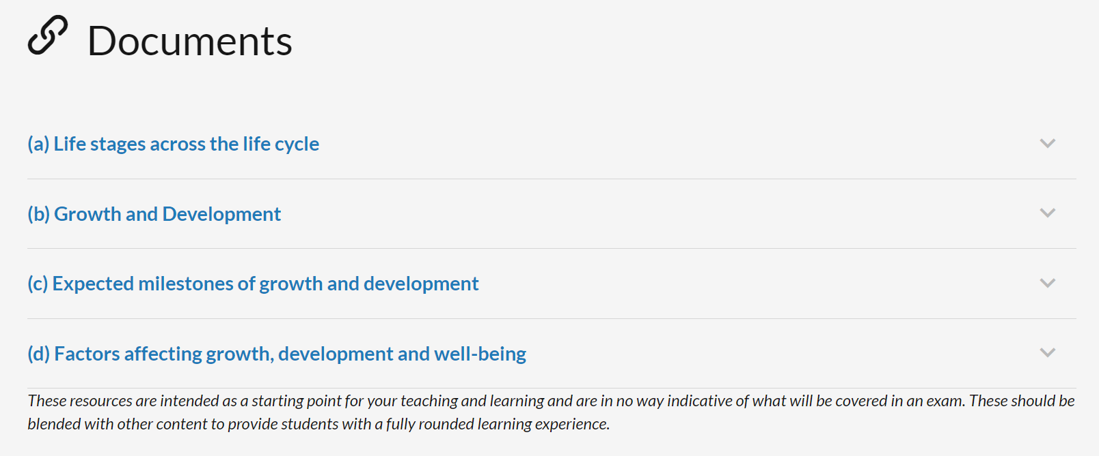
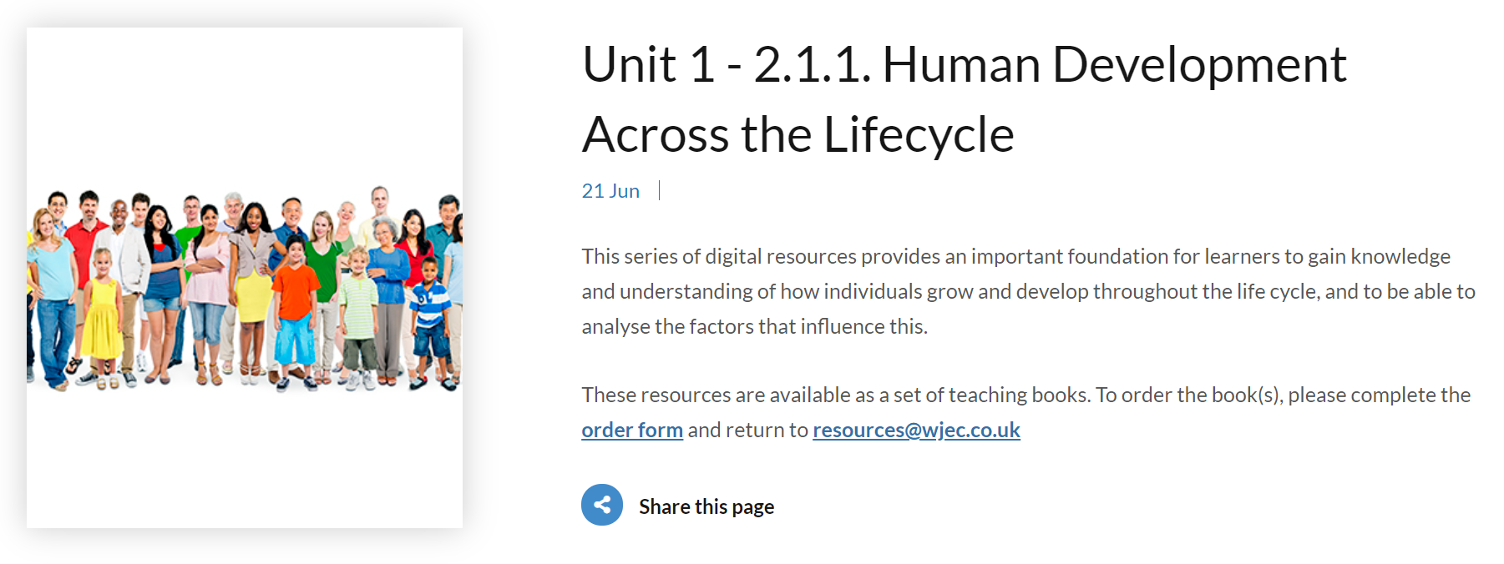
Resources and Support
There is a wide range of both digital and physical resources to enhance your learning experience.
A Google Classroom with resources, links, practice exam questions and sample Coursework tasks will be available.
Parents/carers can support their children by talking about their own experiences of the Health, Social Care and Childcare services, and there are a wealth of documentaries and programmes that can be viewed on demand to gain more insight into the various areas of service delivery.

